Slide 1

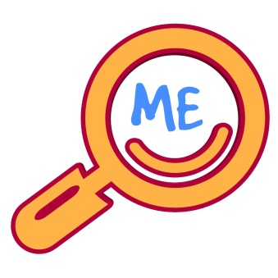
ME DISCOVERING YOURSELF

Slide 2

BY
AKILA
AKSHAYA
GAYATHRI
GNANAPRIYA
HARINI PAVITHRA
ISHWARAYA
DEPARTMENT OF COMPUTER SCIENCE AND ENGINEERING
SRI SAI RAM ENGINEERING COLLEGE

Slide 3
PROBLEM STATEMENT
Ministry: Ministry of HRD
Mind Education System: Increasingly, a number of countries including developed countries are giving a lot of importance to the Mind Education in the Education system of the country. With the increase in the suicide rates, attacks for minor issues, intolerance, the issue of Mind Education system becomes very important. How to incorporate a Good Mind Education in our Education system is a big challenge. Education should while making a person more knowledgeable also should make him/her a better human being.

Slide 4
ABSTRACT
Today the number of suicide rates, intolerance and other minor issues of the students are increased. This is due to their mental stress that causes lack of concentration in studies and other activities. In order to reduce their mental stress THE MIND EDUCATION SYSTEM is introduced. The mind education system is nothing but empowering the students towards a better education. It mainly concentrates on developing games, fun videos related to their studies, attracting easy math calculations, and many more which will help the students to learn things easily. Our ultimate aim is to create an application that equip the students with mental skills. This applications will have a login page through which student get into the app, and a page that will help to identify the stress of the student and will leads to the games or videos that gives the relief or articles related to their stress. By using this application we can easily improve their skills and provide them Stress free life.

Slide 5
PROPOSED PROJECT
Our idea is to create an Application based on the MIND EDUCATION SYSTEM
The application consists of
1.Games
2.Inspring videos
3. Stress identifier
4.Article reading
5.Quotes

Slide 6
6.Jokes sharing
7.Diary writing
8.Talent Exhibition
9.Advice from the psychiatrist
10.AI face recognition
Let us briefly explain the features of application -ME

Slide 7

FIRST PAGE OF APPLICATION -ME

Slide 8
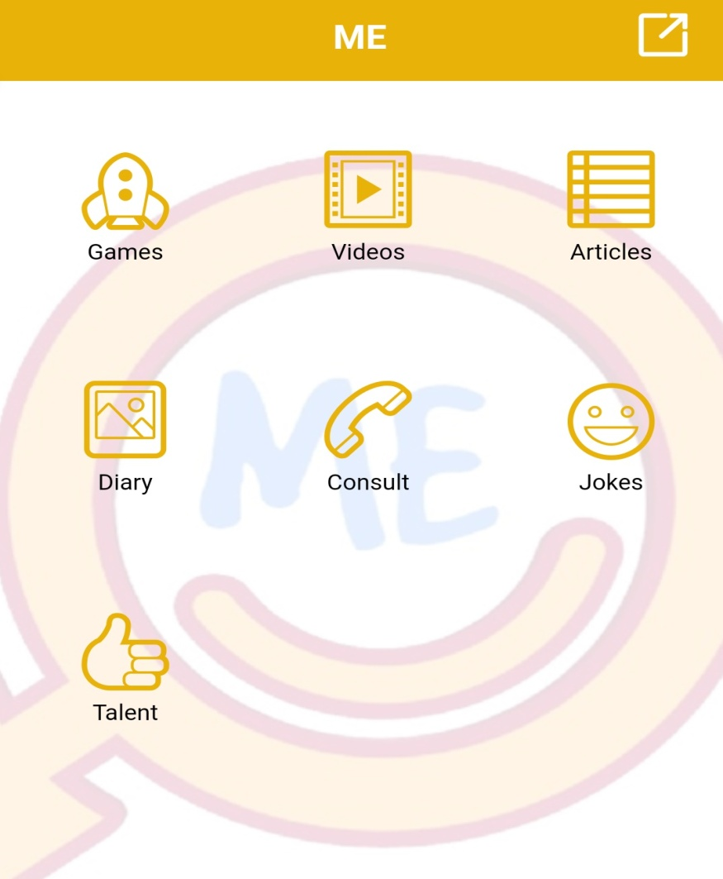
Main PAGE OF THE APPLICATION-ME

Slide 9
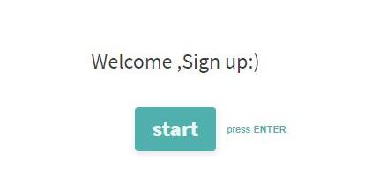
WORKING
STEP 1: SIGN UP

Slide 10
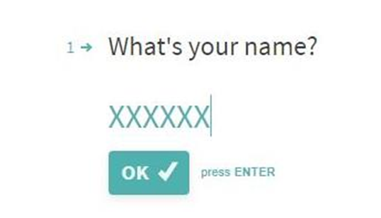
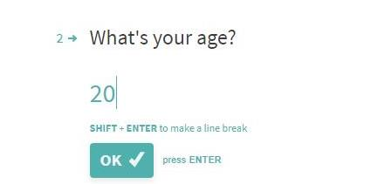

Slide 11
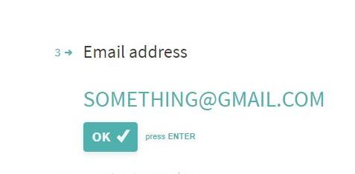
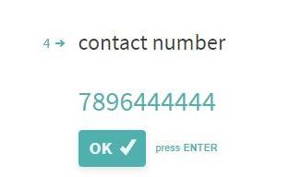
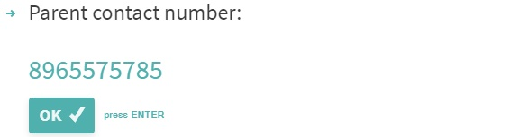

Slide 12
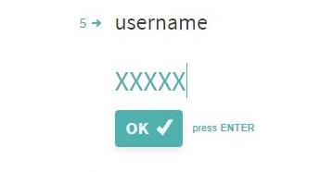
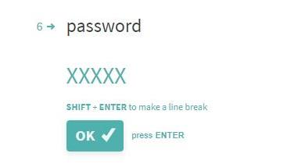

Slide 13
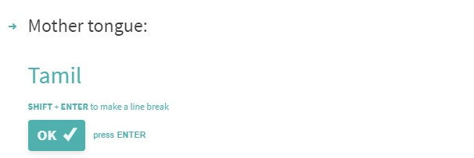


Slide 14
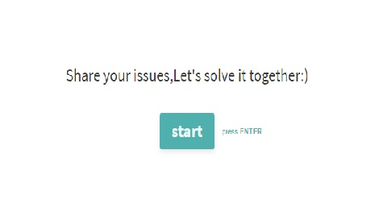
After submitting the form an OTP[ONE TIME PASSWORD] will be generated and sent to the mobile Number for the VERIFICATION of the number
STEP 2: ISSUE IDENTIFICATION
Based on the issues faced by the user , appropriate guidance is provided by the means of games ,videos ,articles .

Slide 15
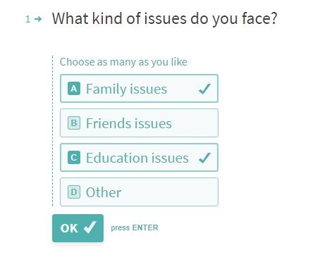

Slide 16
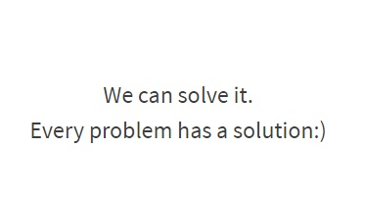

Slide 17
STEP 3: STRESS IDENTIFIER
The next step is identifying the current level of stress of student .
For this we use the technique called PHOTOPLETHYSMOGRAPHY.
This technique finds the heart rate variability and discovers the rate of stress.
STEPS INVOLVED;
The camera and the flashlight of the phone should be activated.
The student should place his/her thumb over flashlight.
The changing of colour indicates the heart beat.
The heart beat variability is checked.
Heart beat variability is nothing but the time interval between each heart beat.

Slide 18
NORMAL PERSON:
AGED 18+
Heart beat between 60 to 100 beats per min.
AGED 6 TO 17
Heart beat between 70 to 100 beats per min.
STRESSED PERSON:
Heart beat greater than 100 beats per min for all age group.
STRESS INDEX:
The heart rate variability graph is drawn.
The stress index is calculated based on graph

Slide 19
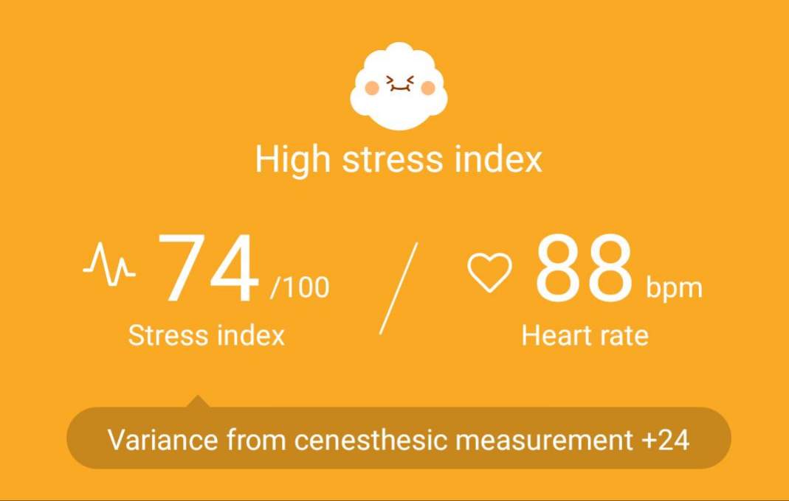

Slide 20
STEP 4: games
we introduce some games for students to reduce their mental stress and improve the concentration power.
The games are loaded from the database based on their stress level.
STUDY RELATED GAMES:
SIMPLE MATH GAME :-
The simple tricks and quiz are discussed here
This game will really helps to sharpen their basic mathematics skills with
unlimited practices.

Slide 21

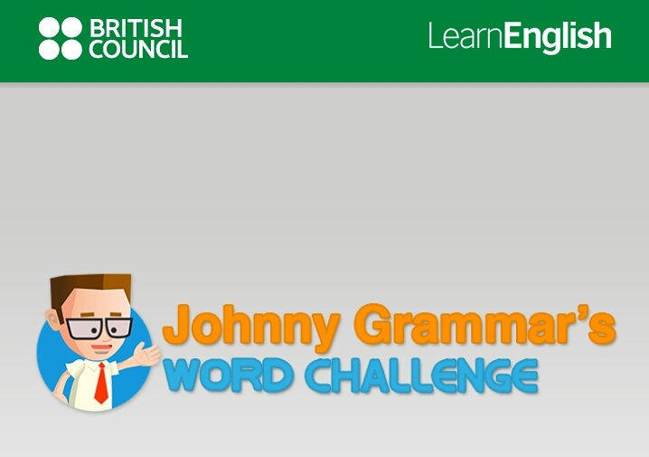
ENGLISH RELATED APP:
One of the primary stress of student is speaking english correctly
To improve their communication skills we provide a link for British council app

Slide 22
OTHER mind RELATED GAMES:
These games are very helpful to solve their stress as well as a first to their future goals . The games are
passion
Decision making
Stop.
Doodle
Jigsaw
Aim creator ETC.

Slide 23
PASSION GAME :
We ask the students to give their 10 passions
From that we help them to discover their top 3 passions
Based on the topmost passions we give them notifications with inspiring quotes.
It makes them to concentrate more to achieve their passion.
AIM CREATOR:
From the 10 passions, the interested field is recognized.
Based on the most interested field the aim is set for the students
Each day the task is to maintain a record of things that he/she done for their aim
A graph is achieved at every weak end based on their record activities

Slide 24
DECISION MAKING:
In most of the cases , we would have observed stress because of improper decision making
We help students to make correct decisions by giving the pros and the cons of each decision they make
With the various pros and cons of their decision, they could finally end up with stress free condition.
STOP:
The game stop is developed to stop evil thoughts.
Because evil thoughts create evil mind
Evil thoughts Such as ego, bad habits, disrespectful, illegal activities etc
To overcome all the activities, we give them mixed word and asked them to find what the word is.
After that they should write a pro and con about the word

Slide 25
From thinking about pros and cons ,they could eventually realize and change themselves.
DOODLE:
Doodle game is designed in order to express their feelings and emotions through a art form.
They would scribble or draw any situation which bothers them.
It develops creative thinking as well as stress handling.
JIGSAW:
Jigsaw is a puzzle consisting of small irregularly cut pieces that are to be fitted together to form a picture,
This improves concentration on a field.
NOTE: At the end of each game we add a motivational quote.

Slide 26
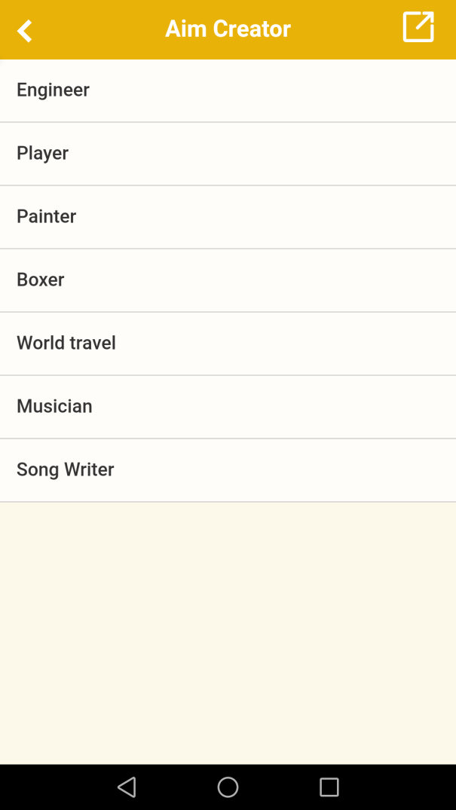
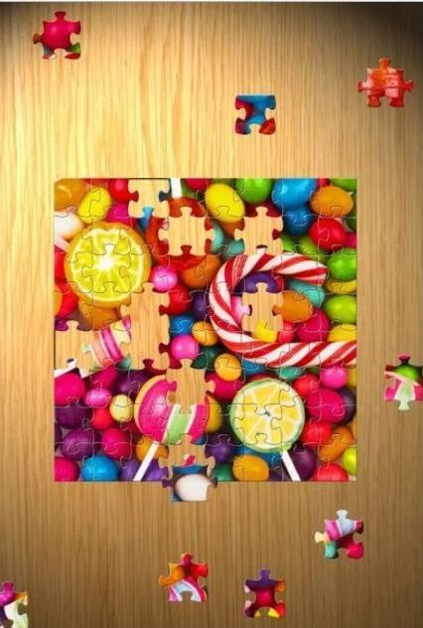

Slide 27
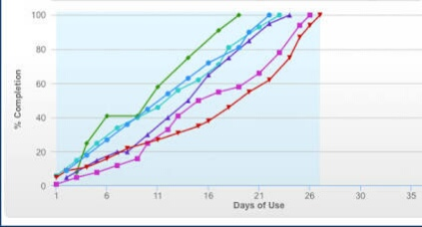

Slide 28


Slide 29
Step 5: INSPIRING VIDEOS:
Every entrepreneur could use a shot of inspiration from time to time. A positive can give you a real Boost.
So We have many kinds of videos for different type of stresses relief.
FAMILY STRESS RELIEF VIDEOS:
Gratitude videos
FRIENDS STRESS RELIEF VIDEOS:
Take it easy videos
STUDY STRESS RELIEF VIDEOS:
Achievement videos
and we have also added motivational , light music videos,

Slide 30
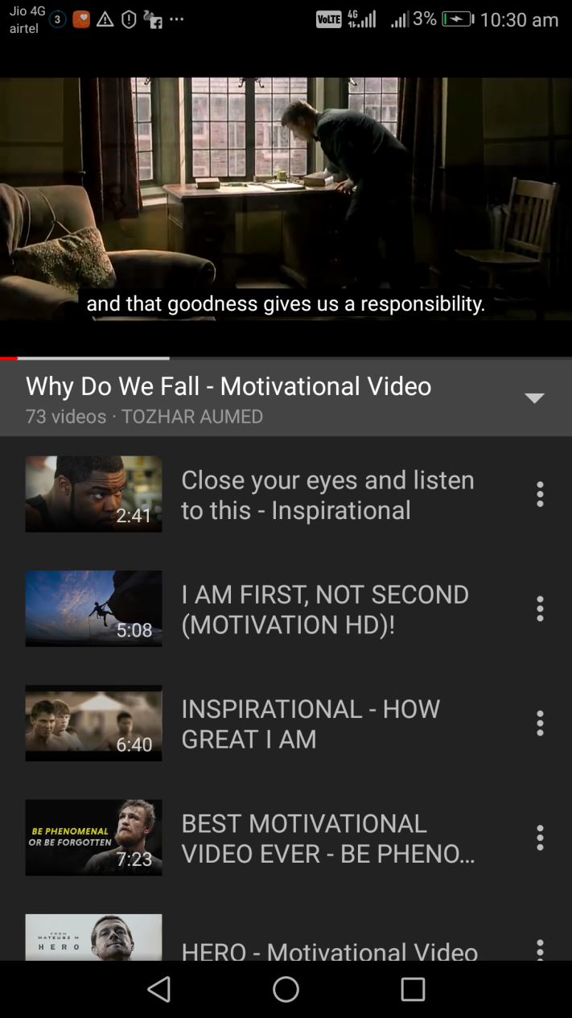

Slide 31
STEP 6: ARTICLE READING
We are adding many inspiring articles which will educate the mind .
Articles based on family , society, friends etc .
These kind of articles will be short and sweet.
The time required for each article is estimated . Based on the time , the review from the user is got.
And it also develops the habit of reading.

Slide 32
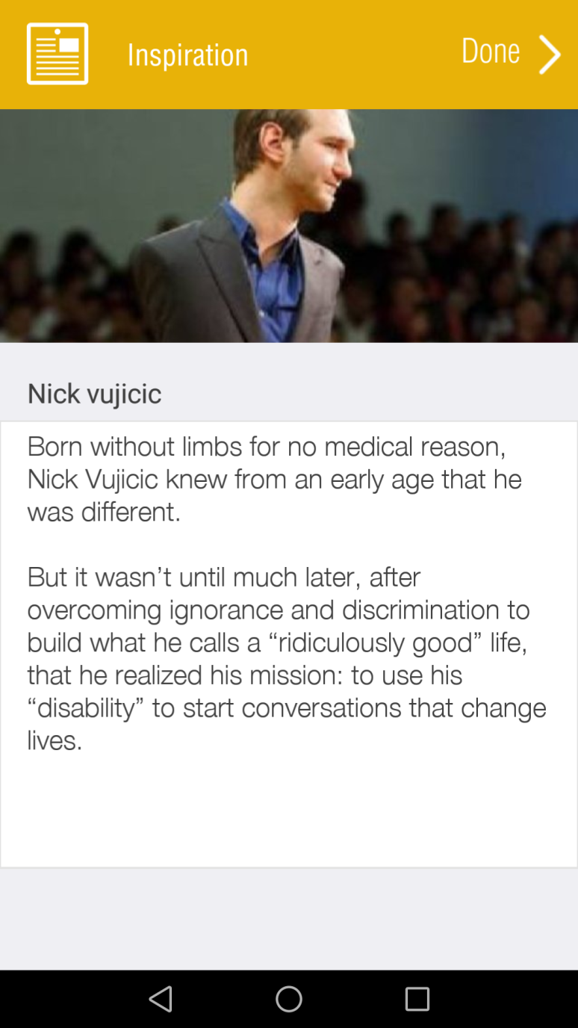

Slide 33
STEP 7: JOKES SHARING
As a part of our application we are adding jokes to relax the person
We also provide facilities to share their own jokes.
The jokes can be provided in all languages.
This increases the creativity of the students .

Slide 34
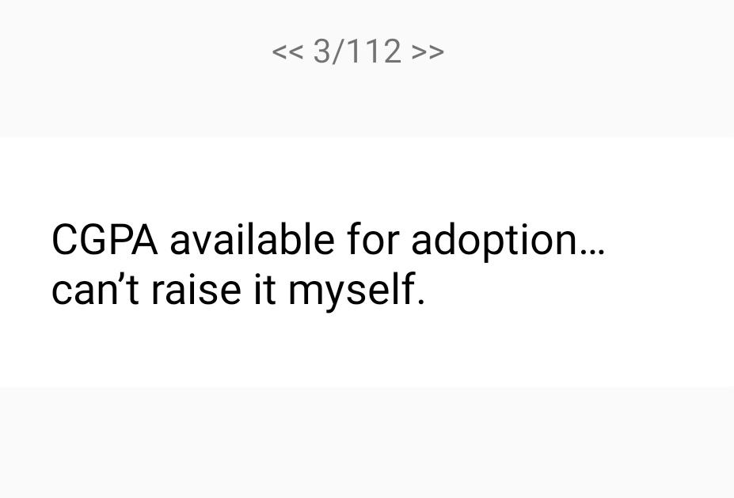

Slide 35
STEP 8:DIARY WRITING
The student never really feel alone as their diary is always with them, to understand their feelings; a part of their life...where they can pour all their feelings without being judged.
Diary can be a great critic, if they read it periodically. It helps them avoid mistakes that they have done, and sometimes, makes them recollect their lessons for life.
Based on the user’s length of data entry and emoticons used the stress level of the student is got. The parent or guardian is notified based on this rating and adviced. The user is also relaxed by suggesting them appropriate videos and articles.
It helps you to improve your writing skills.
The student become more at ease with themselves.
They become more observant.
They improve as a person.

Slide 36
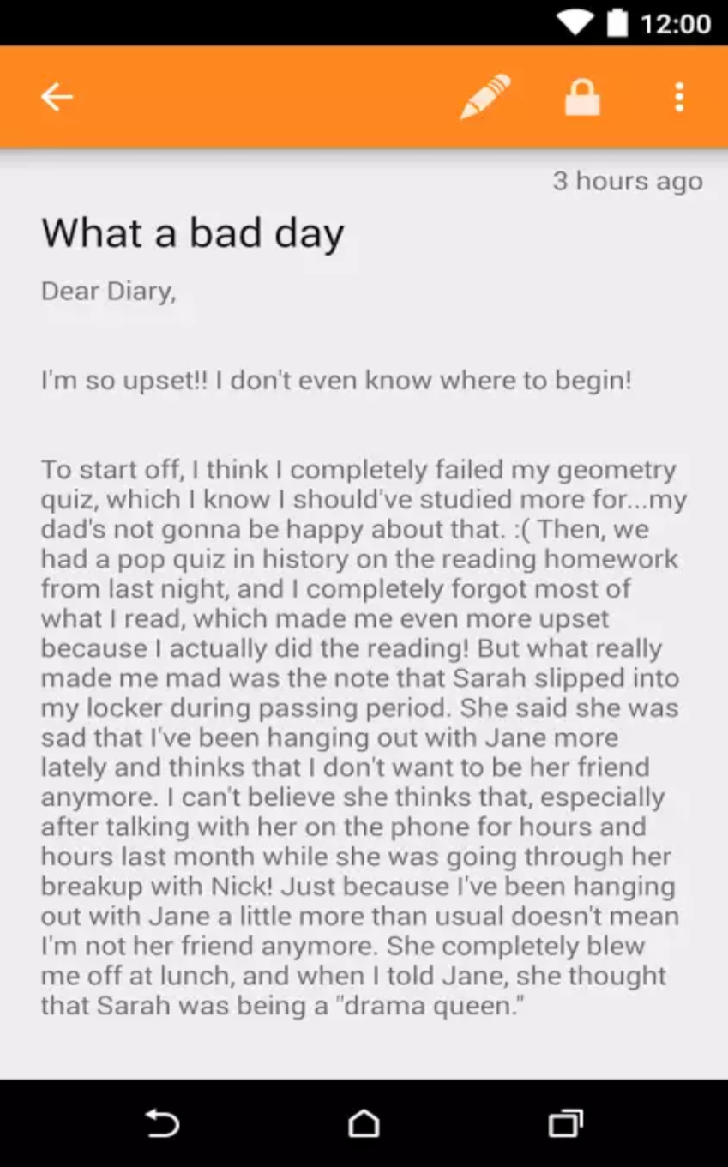

Slide 37
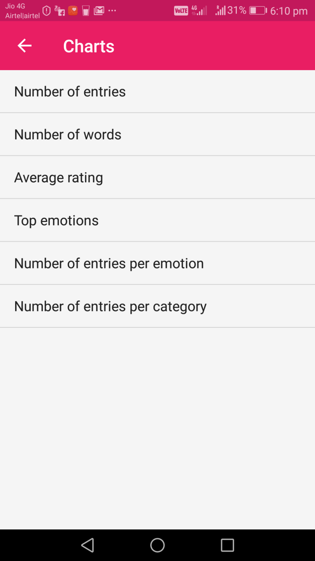
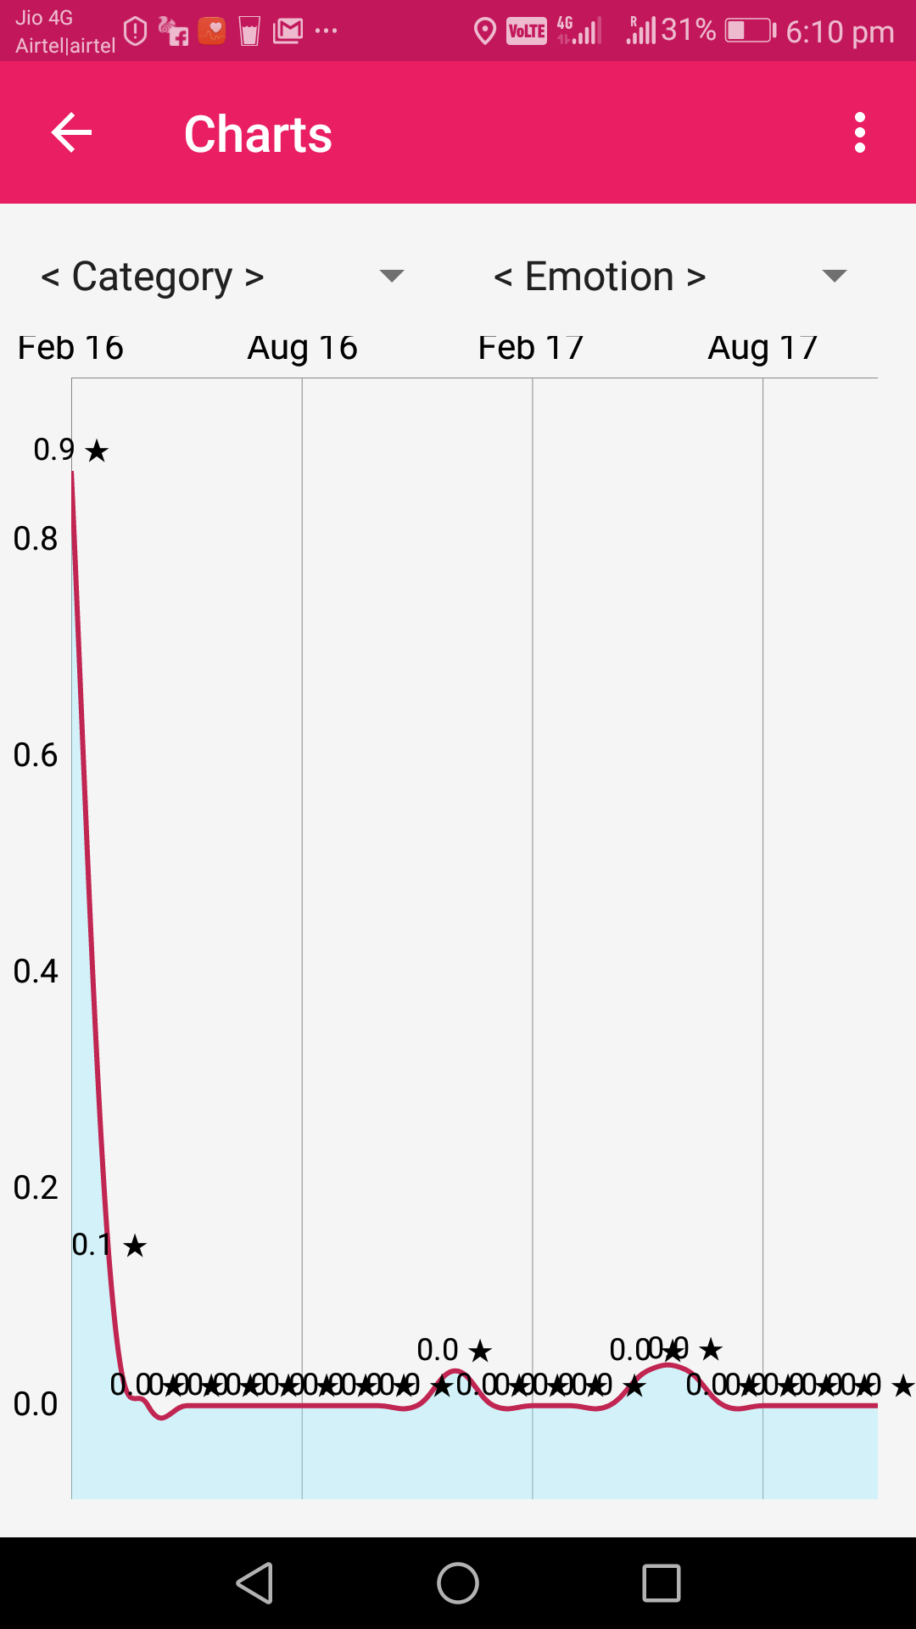
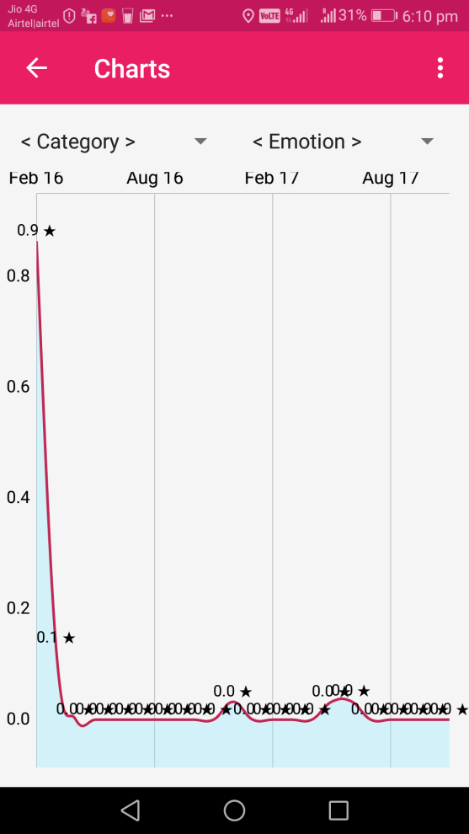

Slide 38
Step 9:talent exhibition
Most of the talents are always hidden .To make the users express their talent,this platform is created.
The interest and talent of the user is got.
The user can post the pictures and videos of the talent like drawing,music skill with tips in a common platform which can be viewed by all users.
The other users can like and post ratings and predefined comments on it.
This helps them to improve their self esteem and their talent.
Using the tips,other interested users can also improve themselves.

Slide 39
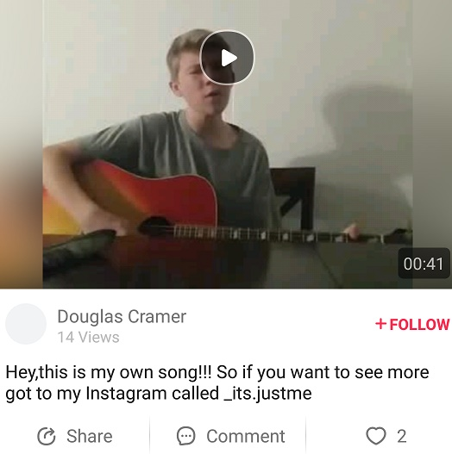

Slide 40
Step 10: Advice from the psychiatrist
If the person is highly stressed even after watching videos ,playing games, reading articles and jokes
He/she can take advice from the psychiatrist.
It can be through a chat or a call

Slide 41
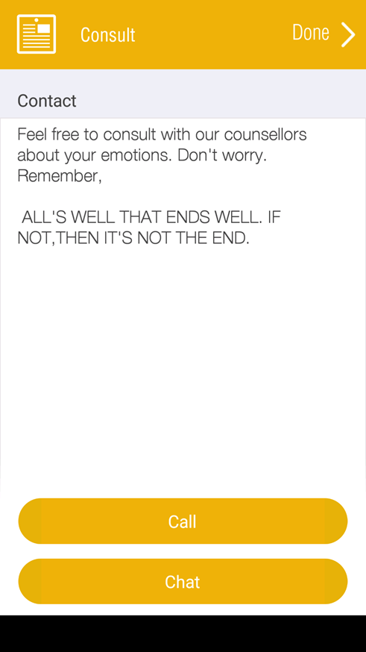


Slide 42
Step 11: ai face recognition
Even after the games , jokes, videos, articles if the person is still in stress ,then we can find it through AI FACE RECOGNITION.
We will ask the student to take a selfie.
AI recognize the facial expression of the student.
If he/she is happy and stress free then he /she can exit the portal.
Even forcing a fake smile decreases the stress.

Slide 43
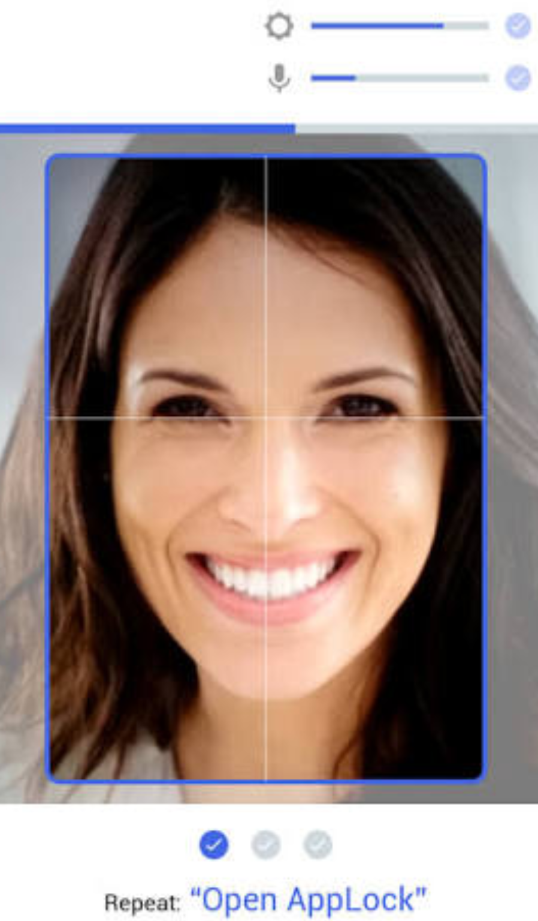

Slide 44
STEP 12: STRESS IDENTIFIER
The same process is repeated once again.
This is the final step.
The first stress level and the second stress level is compared
If the stress is decreased then they are allowed to exit the group
Else a new chat is assigned with the psychiatrist.
And aslo a notification is sent to their parents number with a note that the person is highly stressed
We aslo recommend the parents some tips to take care of their children

Slide 45
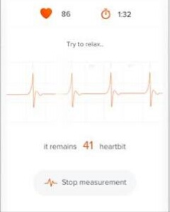

Slide 46
OVERALL ARCHITECTURE

Slide 47
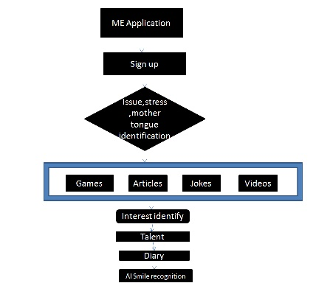

Slide 48
HARDWARE REQUIREMENTS
2 GB RAM
OCTA CORE PROCESSOR
SOFTWARE REQUIREMENTS
Android os
Front-end : java8
Back-end: SQLite 3.9
Development: Android studio

Slide 49
ADVANTAGES
Makes learning simple.
The personality of the student can be developed
It also provides the mathematical games through which they can easily understand the concepts and calculations.
The english language can be learned easily with practise and test conducted by experts
ANY level or kind of stress can be reduced .
It will help them to come out of stress Easily

Slide 50
It gives them the knowledge about the problems and solution.
This will stronger their mind set and make them strong enough to tolerate every problem.
The Application can be handled easily.
It can be accessed Anytime and anywhere .
It is a mobile friendly application.
The better education , suicide reduction and reading habits ,creative thinking are encouraged through this application

Slide 51
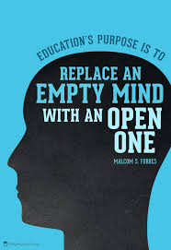
THANK YOU ☺

